Slide 1


Bangladesh University of Engineering & Technology
CSE 408
SOFTWARE DEVELOPMENT SESSIONAL
Proposed Software:
Project Management System
BUET, CSE
01

Slide 2


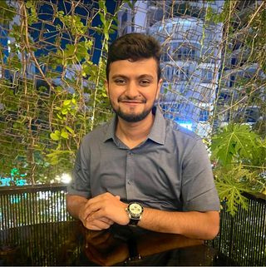

MEET OUR
TEAM
MD. NABIL SADIQUE (1905006)
MD. HUZZATUN ALI (1905027)
ASIF AL SHAHRIAR (1905040)
NABIL
5
HUZZATUN
GROUP
NUMBER
ASIF
BUET, CSE
02

Slide 3

PROJECT OVERVIEW
Improve project management collaboration with real-time communication, reporting tools, task comments, role-based access, mobile accessibility, and regular check-ins for streamlined workflows and transparent communication.
1
Improve Collaboration
Reviewing and monitoring the status of tasks and milestones is made easier. Detailed records of progress, changes, and outcomes will help complete a project more efiiciently.
2
Progress Tracking
Leverage graphical representations, such as charts and graphs, to elucidate intricate datasets effectively, employing visual aids for enhanced comprehension and analysis.
3
Enhance Visibility
BUET, CSE
03

Slide 4

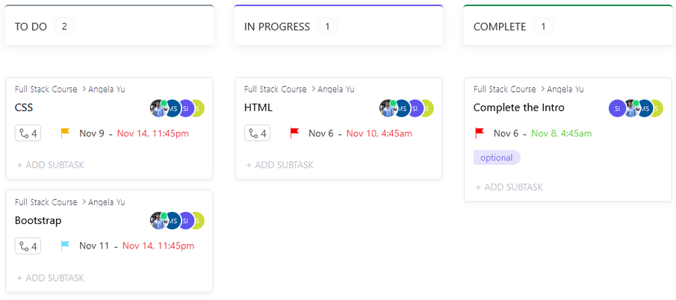
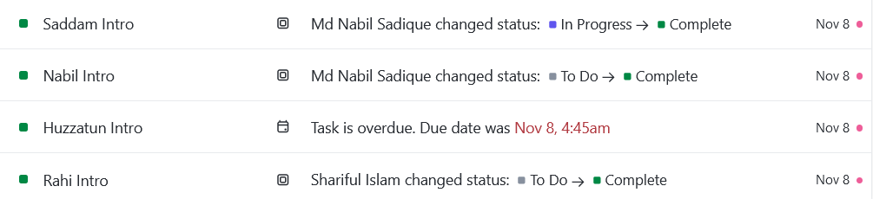
IMPROVE
COLLABORATION
Features for
Improved Collaboration
Notification Dashboard
Role Based Access Control
Kanban Board
Task Comment
Client Collaboration & Feedback
Kanban Board
Notification Dashboard
BUET, CSE
CREDIT: www.clickup.com
04

Slide 5
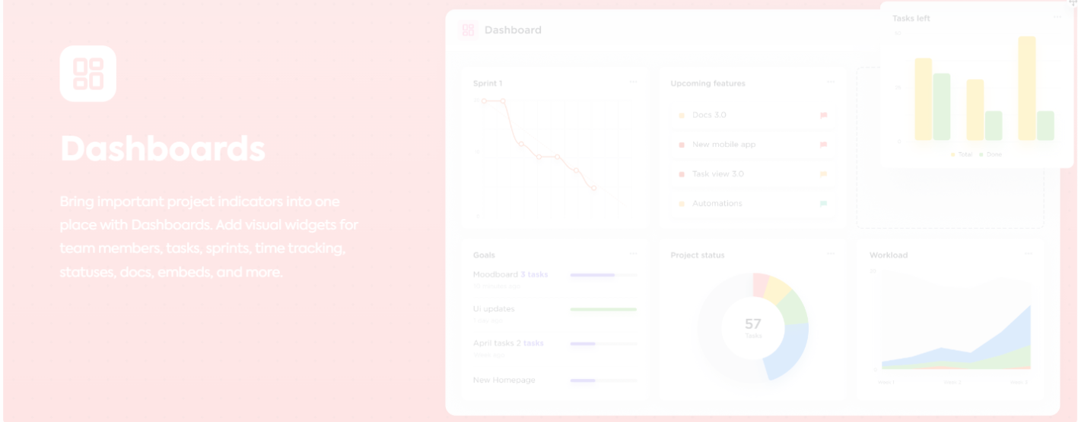
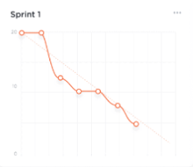
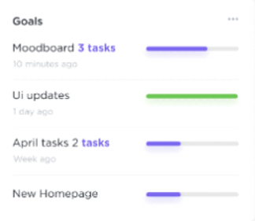
ENHANCE
VISIBILITY
Dashboard gives
A clear visualization about the project and its goals
A clear idea of the persons associated with the project and their roles
Checking-in and Reporting Analytics
Providing Risk Heatmap Overview
BUET, CSE
CREDIT: www.clickup.com
05

Slide 6
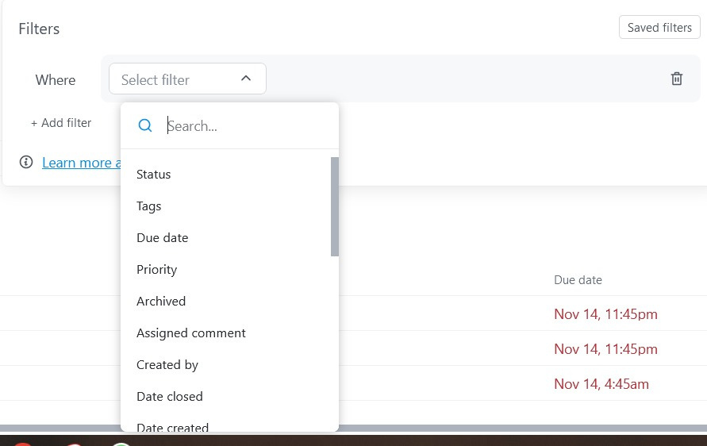
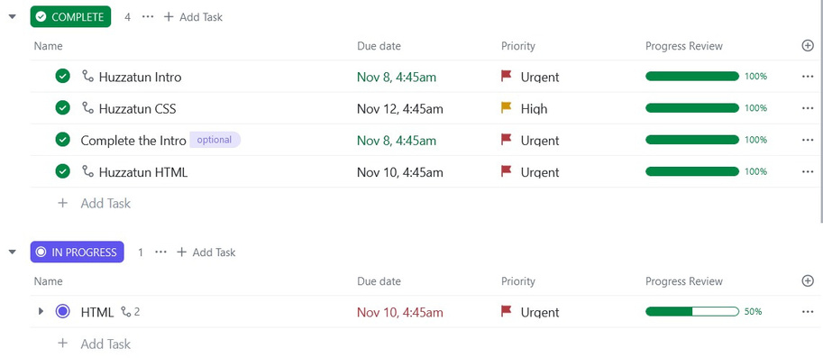
PROGRESS
TRACKING
Filter the progress result with respect to various attribute (Quality , Scope Mangement etc)
Progress Tracking
Workflow & Benefits:
Provide an easy way to track all the progress of the project
Track the record of each worker. Payment can be given to the workers according to their contribution
It helps to complete the project before deadline
BUET, CSE
CREDIT: www.clickup.com
06

Slide 7

THANK YOU
07

